Slide 1
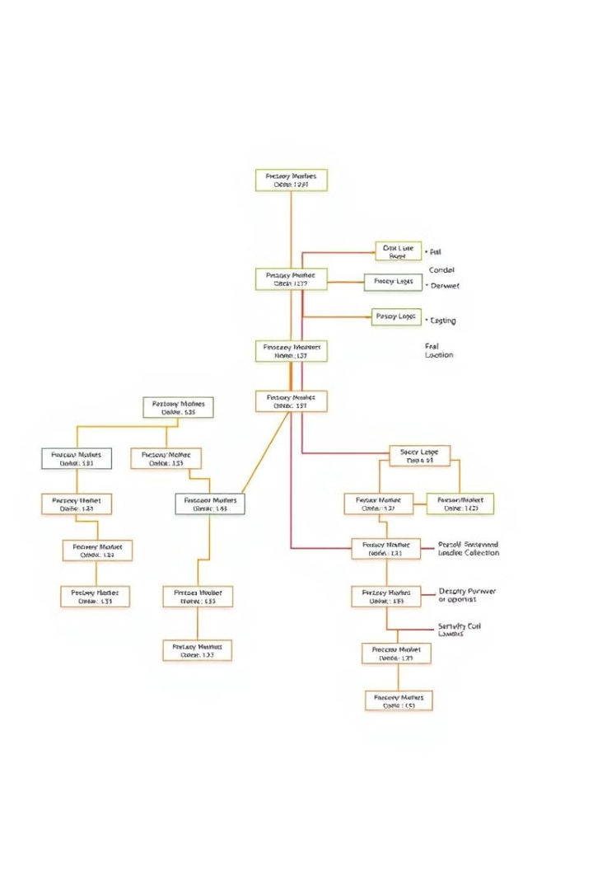

Decision Tree Algorithm for Classification Models
In this presentation, we will explore the fundamentals of the decision tree algorithm and its application in building classification models. From understanding the key concepts to evaluating the performance, this comprehensive overview will equip you with the knowledge to leverage the power of decision trees in your data analysis and modeling efforts.
by Mentor

Slide 2
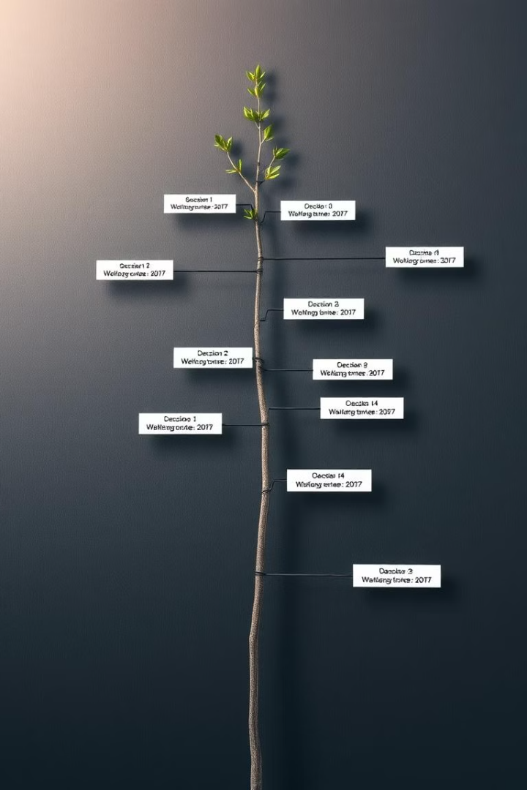
Introduction to Decision Trees
1
Hierarchical Structure
Decision trees are a type of supervised learning algorithm that recursively partitions the input space into smaller regions based on feature values.
2
Intuitive Visualization
The hierarchical structure of decision trees provides an intuitive way to visualize the decision-making process and understand the underlying logic.
3
Classification and Regression
Decision trees can be used for both classification and regression tasks, depending on the nature of the target variable.

Slide 3
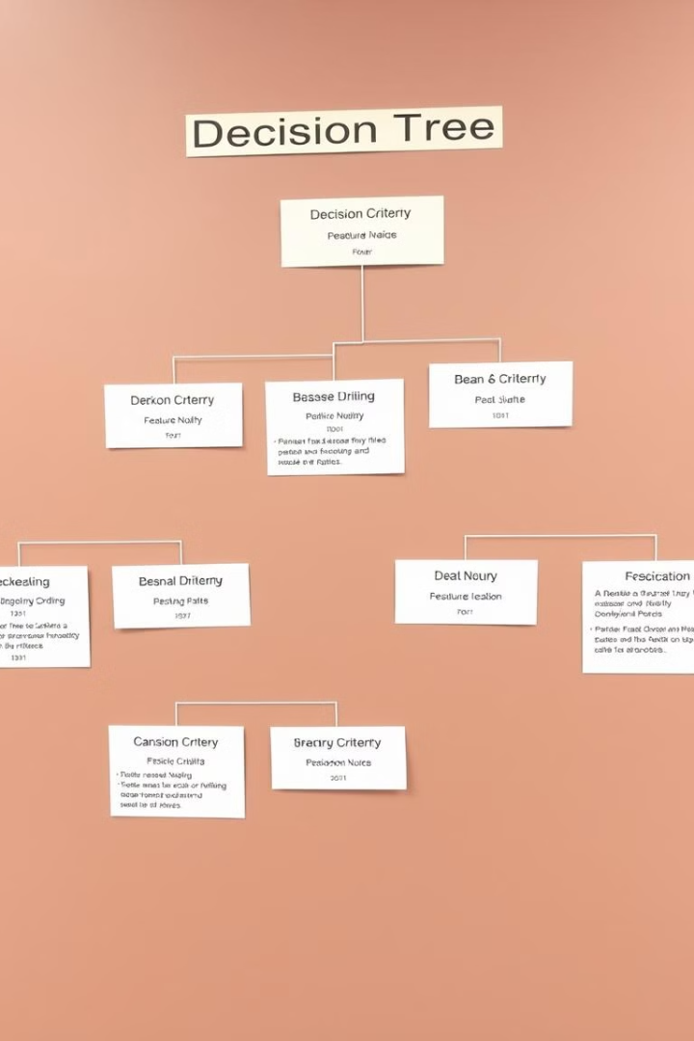
Key Concepts of Decision Trees
Node
Branch
A node in a decision tree represents a feature or attribute used to make a decision.
Branches represent the possible values or outcomes of a decision made at a node.
Leaf Node
Root Node
Leaf nodes represent the final classification or prediction made by the decision tree.
The root node is the top-most node in the decision tree, where the algorithm starts the decision-making process.

Slide 4
Building a Decision Tree
Data Preparation
Feature Selection
Tree Construction
Ensure the dataset is clean, relevant, and appropriately formatted for the decision tree algorithm.
Identify the most informative features that will help the decision tree make accurate predictions.
Recursively split the data based on feature values to grow the decision tree and create the hierarchical structure.

Slide 5
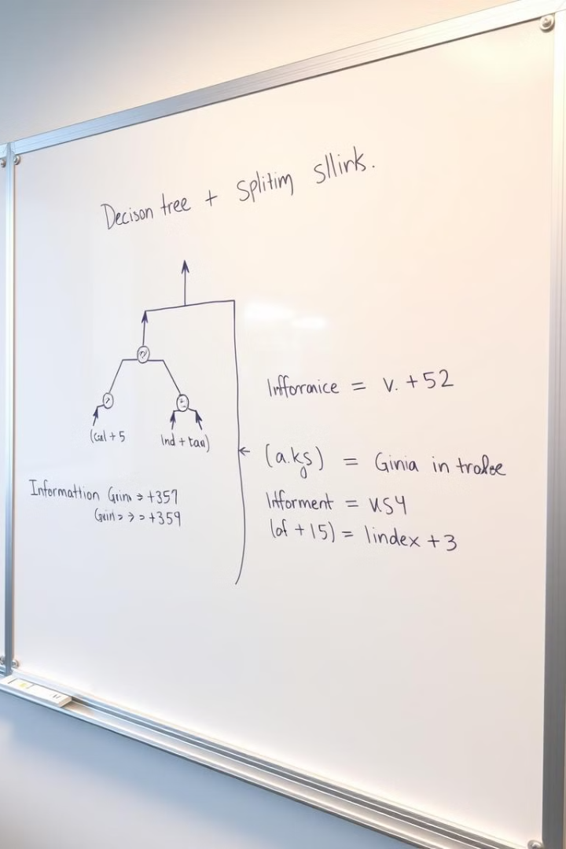
Splitting Criteria (Gini Index, Information Gain)
1
Gini Index
2
Information Gain
A measure of impurity that evaluates the likelihood of a random sample being misclassified.
Measures the reduction in entropy or uncertainty when a feature is used to split the data.
3
Optimal Splitting
The decision tree algorithm selects the feature that maximizes the Gini Index or Information Gain to split the data at each node.

Slide 6
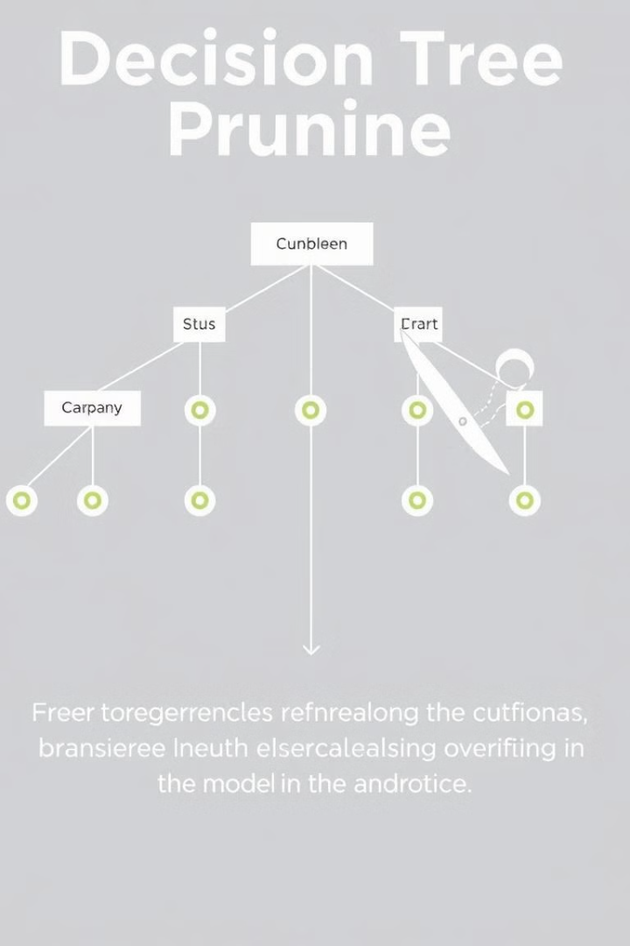



Pruning and Overfitting
Overfitting
Decision trees can become too complex and fit the training data too closely, leading to poor generalization on new, unseen data.
Pruning
Pruning techniques are used to simplify the decision tree and prevent overfitting by removing unnecessary branches.
Balanced Complexity
The goal is to find the right balance between model complexity and generalization performance.

Slide 7
Advantages and Disadvantages of Decision Trees
Advantages
Disadvantages
Intuitive and easy to interpret
Prone to overfitting if not properly pruned
Can handle both numerical and categorical features
Sensitive to the way the data is split
Robust to outliers and missing values
May not perform well on large, high-dimensional datasets
Able to capture non-linear relationships
Cannot extrapolate beyond the range of the training data

Slide 8
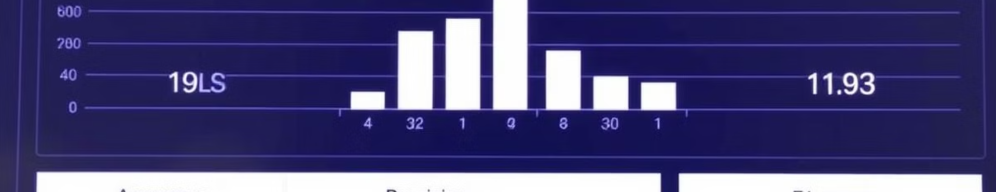




Evaluating Decision Tree Performance
Accuracy
Precision
Recall
F1-Score
The proportion of correct predictions made by the decision tree model.
The fraction of true positive predictions among all positive predictions.
The fraction of true positive predictions among all actual positive instances.
The harmonic mean of precision and recall, providing a balanced metric.

Slide 9
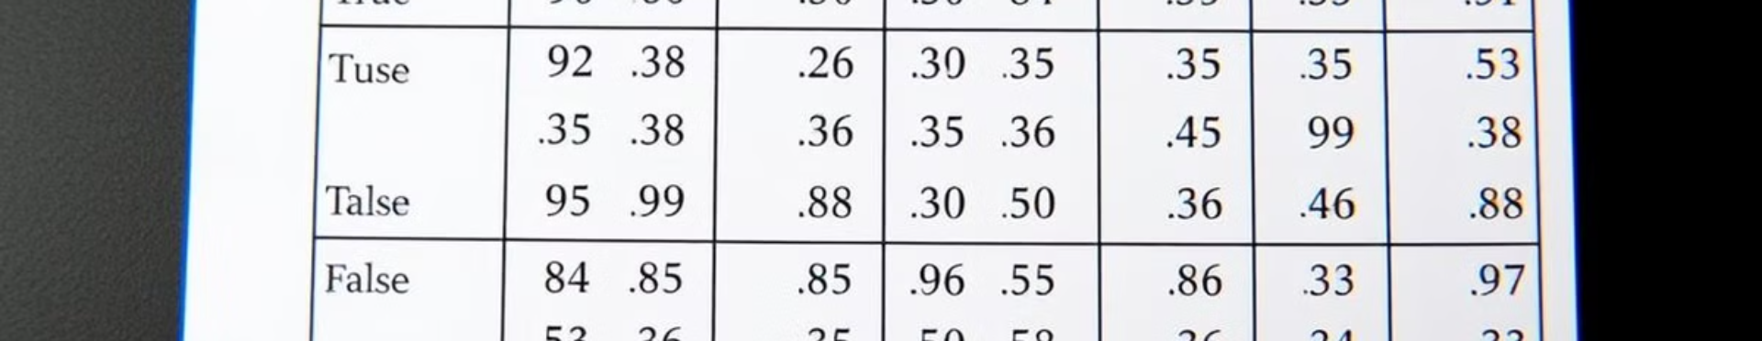
Confusion Matrix and Evaluation Metrics
Predicted Positive
Predicted Negative
Actual Positive
True Positive (TP)
False Negative (FN)
Actual Negative
False Positive (FP)
True Negative (TN)
These evaluation metrics provide a comprehensive assessment of the decision tree model's performance, enabling you to understand its strengths, weaknesses, and suitability for your specific classification task.

Slide 10
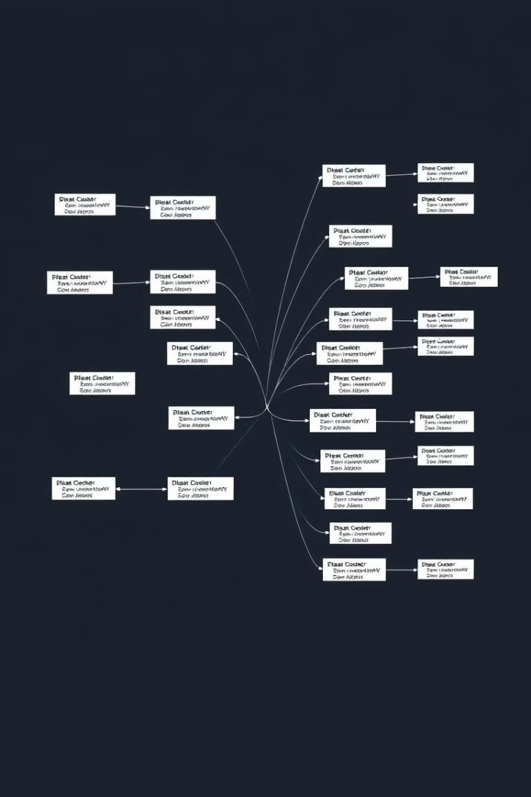
Conclusion and Future Considerations
1
Ongoing Improvements
2
Ensemble Methods
Decision tree algorithms are continuously evolving, with new techniques and enhancements to improve their performance and applicability.
Combining multiple decision trees, such as in random forests or gradient boosting, can further enhance the model's predictive power.
3
Adaptability
Decision trees can be adapted to handle a wide range of classification problems, making them a versatile tool in the data scientist's toolkit.
As you continue your journey in machine learning, remember the key principles and best practices of decision tree algorithms. By understanding their strengths, limitations, and evaluation techniques, you can leverage this powerful tool to tackle your classification challenges effectively.

